Slide 1
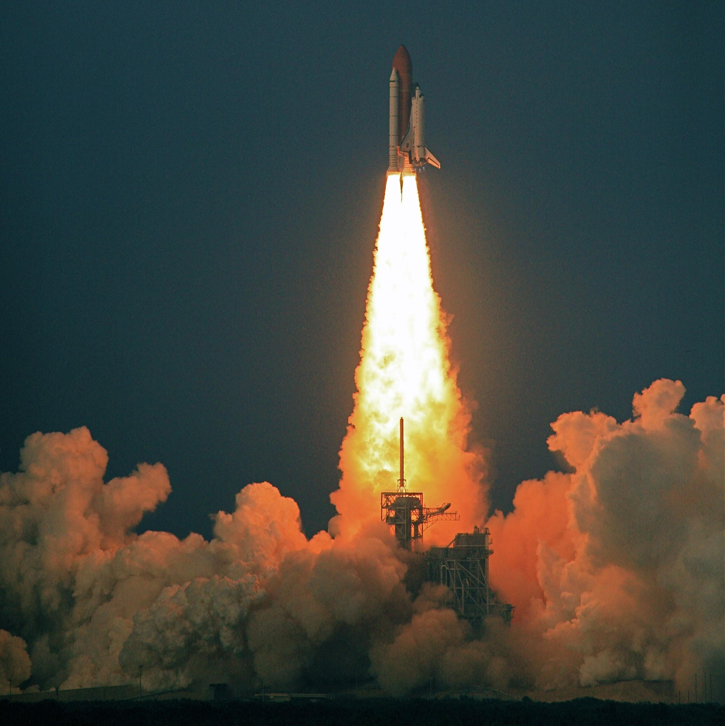
FINAL PROJECT KICKOFF!

Slide 2
Outline for today
Logistics
Development process
Project Q&A & Advice

Slide 3
Logistics
Schedule:
Hop-in tech dry run: November 8th
Presentation dry run: November 9th
Demo day: November 10th
Audience: employers, peers, family, mentors
Walk your friends/family through the presentation website beforehand!
Length: 5 minutes (strict)
Private session rooms afterwards
Make sure to fill out the google sheet posted by Kyla in the slack (finalize by week 11)
Descriptions will be sent out to potential employers attending demo day
Descriptions will appear in your session rooms on Hop-in
Speak to a mentor ASAP to get your project cleared

Slide 4
Development process

Slide 5
Scoping your project
Essential
Additional considerations
What is the dataset, and is there one available?
What are the inputs/outputs of the model (as numbers)?
What do you want to do with your model (if anything)? Experiments? Applications?
Is machine learning necessary?
Unless you want a big challenge, avoid having to learn something new (eg reinforcement learning, GANs)
Is there prior work to help you out?
Is it computationally expensive?
Notes:
Dataset:
Can have a great idea, but no readily available dataset. Check Kaggle, Google Dataset Search.
Spend some time researching this thoroughly, not just looking at the dataset name. Get a sense for how easy it will be to process the data and get it in a form appropriate for modeling, as this may take the bulk of your time.
If doing deep learning, caution against making your own dataset, unless you’re ready to spend several hours annotating. If you do this, you really should be finetuning a pretrained model.
Inputs/outputs:
Picking the model is simple after this, and you should be thinking about inputs/outputs before you even think about what models you want to work with.
As numbers (e.g. don’t say “outputs emotion of a face”; how is emotion being represented numerically?).
Dataset and inputs/outputs jointly define exactly what the task is. If you cannot specify what the dataset and what the numeric inputs/outputs are, then your project is not specific enough and you will not be able to manage it correctly.
Make sure you can specify the dataset and task inputs/outputs before you start working on the project.
This is what a mentor will be looking for when you explain your project to get it cleared.
Experiments:
Example: Dog/cat classifier, but specifically to find out which animal is more popular in memes on twitter.
Example: COVID twitter sentiment correlations.
ML necessity:
Can have a cool-sounding idea, but remember that humans were able to do a lot before ML. ML good for tasks with a lot of hidden patterns and complex input-output mappings for which we don’t know the underlying principles.
Example: Model that tells me how to get from A to B fastest. There are well-known non-ML algorithms to solve this problem that are guaranteed to get the optimal solution.

Slide 6
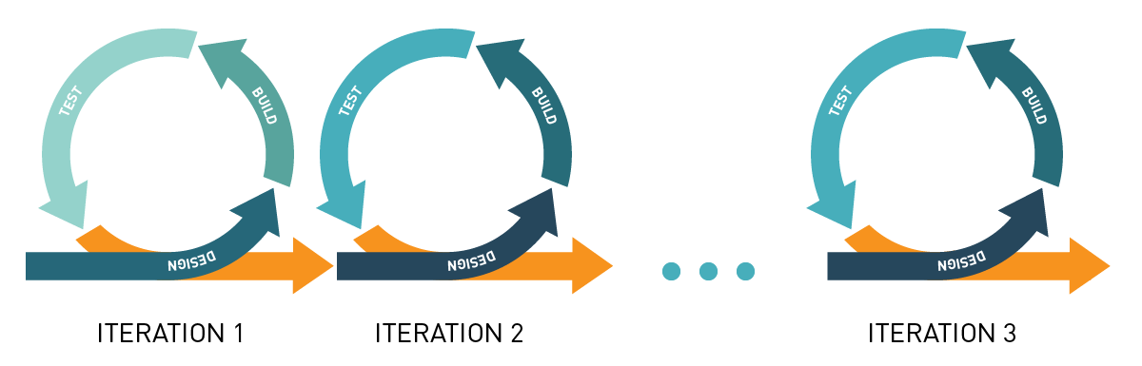
Iterative progress and difficulty
Make a minimum viable product (MVP) early
Dataset difficulty (eg simple or synthetic data before complex real world)
Model complexity (eg linear autoregressive before LSTM)
Task complexity (eg simplest solution before multifaceted)
Notes:
Reasons:
Easier to avoid bugs. Make sure simple things work before moving on. Example: if LSTM isn’t training, is it because your hyperparameters were wrong, or because you preprocessed your data incorrectly? Is there a bug?
Learn as you go along. Working on a project makes the challenges clear. Better to figure out the challenges in a simplified context so that you scrap less code that you spent a long time working on.
Setup benchmarks.
Avoid catastrophic failure of any results. Get something working for demo day, then build on it for as long as you can. MVP.
Dataset difficulty:
Can also work with simplified synthetic datasets with less variation before moving onto complex real-world datasets. Example: for music data, synthetic single-instrument piano before real multi-instrument audio.
Task complexity:
Avoid scope creep. Focus on the simplest framing of your problem possible and then gradually expand.

Slide 7
Milestones
Research prior work
Acquire/preprocess/explore dataset
Design model
Train and evaluate model
Version 1 of your capstone
Perform experiments (if any)
Deploy model (or make figures)
Finish presentation
Each item must be: a) Dated b) Specific
Notes:
Research:
If you’re finding a lot of garbage on Google, use Google Scholar.
Doesn’t have to be your exact task, can be a related one. Example: if you’re making an image classifier for cars, research image classification in general.
I would spend an entire day on this. Can save you a lot of time, giving you a clear idea of the challenges and methods involved.
The design of the model should really only be its own step if you’re using a complex model with many subcomponents. For simple classification or regression task, not necessary.
In an iterative approach, would have iterations of these steps and achieve them each in turn in a cycle (except for the research and presentation steps).
Hold yourself accountable to your dates. 2 weeks is not much time and stagnating on one step can have cascading problems. This is why I emphasize that your process should be iterative so that you know you can meet your deadlines.

Slide 8
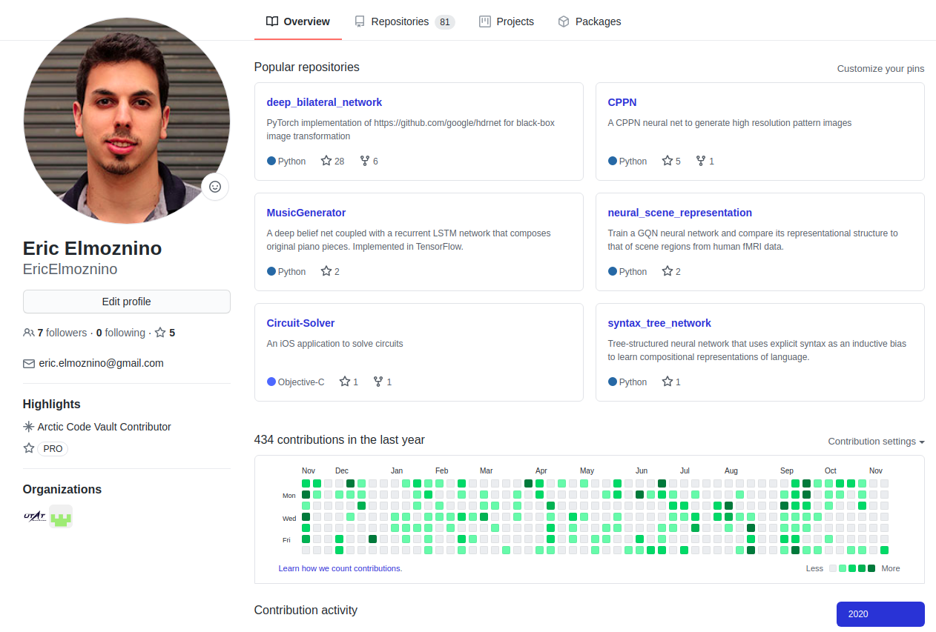
Why use git?
Public: Employers can see all the projects you’ve worked on
Versioned: You will have a history and can roll back to old commits
Server deployment: Just git pull to any new machine
Teamwork: Everyone can work on their own copy and working versions to the master copy
Notes:
A link to your GitHub should be something that’s on your resume. Many companies will ask for it explicitly.
At the end of the course, you should really consider publishing all the mini-projects you managed to finish to GitHub. Clean up the code a bit, then publish. The more employers can see you worked on, the better.
Some time during university, I started publishing every project I worked on on GitHub. School assignments, little side projects, big projects, work projects, research projects. Slowly, you start building a presence. Now when an employer goes to my page, they see that I have 81 repositories, I commit really often, I have many different kinds of projects with cool-sounding titles, and some of those projects are being followed or have been forked by others. It takes time to create a presence on GitHub, but if you make it your code cloud storage rather than something like Dropbox, building that presence takes very little effort. It will just happen.
No employer has ever told me “we looked at your GitHub and your code from 5 years ago sucked”. Don’t worry about code that you think might be ugly, it probably isn’t. In any case, the main thing they’re going to look at is the names of the repositories and the number of them that you have.
Your commits will also have text descriptions to remind you of what state the project was in, so you know where to roll back to.

Slide 9
Capstone Example on Github
https://github.com/GovindSuresh/reducing-bias-in-toxicity-classification
https://github.com/nomadtomas/sentweetment_analysizer
https://github.com/Greenford/billboard

Slide 10
Deployment and demo options
Don’t need to deploy or demo anything; good figures can be just as good
If you have something like an image emotion classifier, a live demo can be cool
If you have something like a cancer classifier, just show us some performance metrics
Consider whether your demo is too long or too risky (30 -45 seconds)
Deployment options:
Flask API (might demo with Postman)
Flask app with UI (harder; need to write HTML)
AWS remote Flask app (if you need a faster machine and have money)
https://www.pythonanywhere.com/ (free)
https://www.heroku.com/ (free)
https://www.streamlit.io/ (good if you want UI, but learning a new library)
Heroku + Streamlit Tutorial

Slide 11
Code
Define functions whenever possible (eg clean_data(df))
Use pipelines for joint preprocessing, feature engineering, and model
If using deep learning, generate training/validation curves as a function of epoch to see if your model is improving
Save trained models and only retrain when needed
Use .py files (.ipynb notebooks for EDA and rough work) so that you can split the project up into multiple files (eg data_cleaning.py, training.py, app.py)
Don’t show any code in your presentation
Notes:
Things that will keep you organized and will minimize your time spent debugging.
Using .py files at least to store functions that load data, train model, etc. That way, your notebook can be more readable and just contain the logic/workflow.

Slide 12
Code quality: modularization
repo/
├── data
│ ├── raw_data.csv
│ └── preprocessed_data.csv
├── src
│ ├── modules
│ │ ├── data_preprocessing.py
│ │ └── modeling.py
│ │ └── figure_generation.py
│ ├── tests
│ │ ├── test_data_preprocessing.py
│ │ └── test_modeling.py
│ └── experiments.ipynb
├── output
│ ├── predictions.csv
│ ├── figures
│ │ ├── process_schematic.jpg
│ └── └── cluster_visualizations.jpg
└── README.md
# data_preprocessing.py
...
def load_preprocessed_data():
...
return X, y
...
# experiments.ipynb
from modules.data_preprocessing import load_preprocessed_data
from modules.modeling import train_models
...
X, y = load_preprocessed_data()
best_model, cv_performance = train_models(X, y)
...
Notes:
If you’re comfortable with it, try to make most of your helper functions in separate .py files and import them into your notebook

Slide 13
Compare to baselines
How good is your model? Contextualize it with a baseline
For classification: always predicting the most frequent y value
Eg always predicting no-cancer if it is the most common class in the dataset
For regression: always predicting the mean y value (implicit in r²)
Eg always predicting the mean flight delay
For forecasting: using a moving average model
Eg always predict the stock price tomorrow will be the average over the past week
For any problem: hard-code a naive solution
Eg for hockey, always predict that the team with the better collective stats will win the game

Slide 14
Presentation structure
Motivation: What is the problem? Why is it important (either business, public good, or research perspective)?
Task: Problem from a technical perspective. Description of the dataset, algorithm inputs/outputs, analyses done using model
Modeling: Important aspects of your approach. How did you process the data or engineer features? What model did you use? Use schematics!
Results: Visuals! Show metrics and experiments. Demo (if any)
Conclusions: What worked? What didn’t (and why)? How are we better off? Where could the project go next?

Slide 15
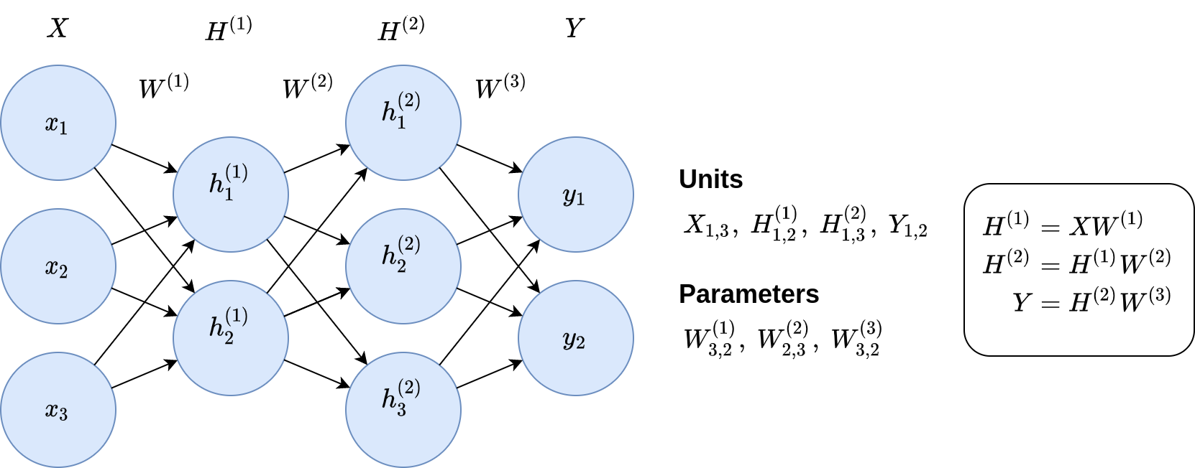
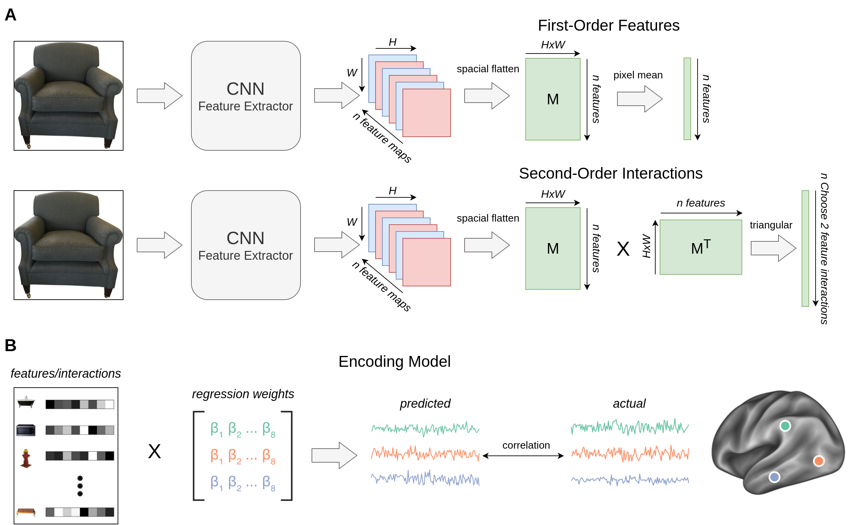
Figures: draw.io
Good for schematics, model diagrams, shapes, math typesetting, etc.
Notes:
Free
Much easier than PowerPoint

Slide 16
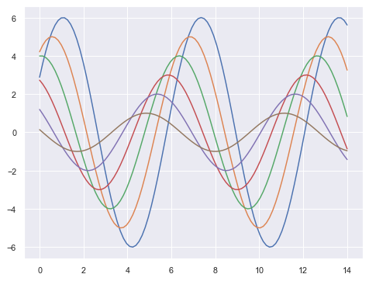
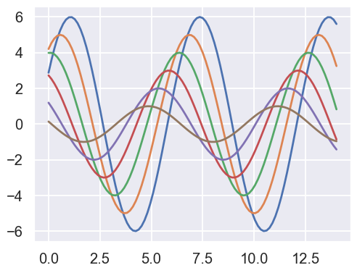
Figures: seaborn
# Right after importing seaborn (could also use 'whitegrid')
sns.set_theme(style='darkgrid', context='talk')
context=’talk’

Slide 17
Activity (30 minutes)
Get in pairs and spend 5 minutes each pitching your capstone idea to one another. (10 minutes)
What is your capstone?
What dataset will you be using?
Any potential challenges?
What is your MVP that you will be happy to achieve before demo day?
Everyone pitch their capstone idea in 1 minute (in main room)
It’s okay if no one has their finalized capstone.

Slide 18
Project Q&A & Advice

